Slide 1
Neural Networks – Intuition & Mathematics
Inspired by 3Blue1Brown
Balanced: Intuition + Equations + Visuals
Focus: MNIST & Backpropagation

Slide 2
The Big Goal
• Recognize handwritten digits (MNIST)
• Learn patterns from data
• Adjust weights using gradients
• Minimize cost function

Slide 3
What is a Neuron?
Mathematical Model:
z = w₁x₁ + w₂x₂ + ... + wₙxₙ + b
a = σ(z)
Weighted sum + Bias + Activation

Slide 4
Vector Form of a Neuron
z = wᵀx + b
a = σ(z)
w → weights vector
x → input vector
b → bias

Slide 5
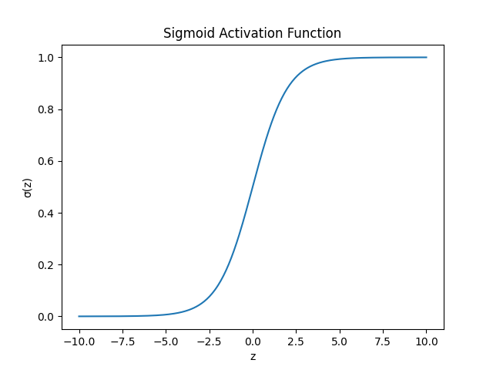
Activation Functions
Why needed?
• Introduce non-linearity
• Enable deep learning
Common:
• Sigmoid
• ReLU
• Tanh

Slide 6
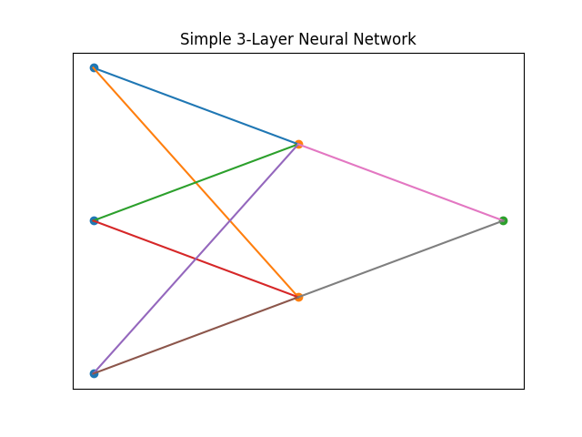
Layered Structure
Input Layer → Hidden Layer(s) → Output Layer
Each layer performs:
z⁽ᴸ⁾ = W⁽ᴸ⁾a⁽ᴸ⁻¹⁾ + b⁽ᴸ⁾
a⁽ᴸ⁾ = σ(z⁽ᴸ⁾)

Slide 7
Cost Function
For one example:
C₀ = (a⁽ᴸ⁾ − y)²
Goal: Minimize cost across dataset

Slide 8
Forward Propagation
Step 1: Compute weighted sums
Step 2: Apply activation
Step 3: Get final prediction
Repeat layer by layer

Slide 9
Backpropagation Idea
We compute:
∂C / ∂w
Using Chain Rule:
∂C/∂w = (∂z/∂w)(∂a/∂z)(∂C/∂a)

Slide 10
Key Gradients
∂C/∂a = 2(a − y)
∂a/∂z = σ'(z)
∂z/∂w = a⁽ᴸ⁻¹⁾
Multiply them together

Slide 11
Gradient Descent
Update rule:
w := w − η ∂C/∂w
η → learning rate
Move opposite gradient direction

Slide 12
Why Deep Networks Work
Layer 1 → detect edges
Layer 2 → detect strokes
Layer 3 → detect shapes
Final → classify digit

Slide 13
Training Process
1. Forward pass
2. Compute cost
3. Backpropagate gradients
4. Update weights
5. Repeat

Slide 14
Interpretation of Weights
Weights represent learned patterns
High weight → strong influence
Network learns automatically

Slide 15
Summary
• Neuron = weighted sum + activation
• Network = layers of neurons
• Cost measures error
• Backprop computes gradients
• Gradient descent updates weights

